Slide 1
IT Security and Penetration Testing
Chapter 6
Encryption and Password Cracking

Slide 2
Objectives
Understand basic cryptographic principles
Understand the fundamentals of encryption
Describe the most common ciphers in use today
Identify the most common attacks on passwords
Use various programs for cracking passwords
Computer Security and Penetration Testing

Slide 3
Encryption and Password Cracking
Strong passwords
  Good defense against unwanted entry
Guessing, stealing, or cracking passwords
  Foundation of defeating any kind of security
Computer Security and Penetration Testing

Slide 4
Cryptography
Cryptography
  Algorithm encrypts a ciphertext document from a plaintext document
  Algorithm decrypts the ciphertext back into plaintext
Transposition
  Change in the position or order of letters or words
  Does not rely on length of password
  Transposition is based on probabilities
  Anyone can break a transposition cipher based on frequency of letters
Computer Security and Penetration Testing

Slide 5
Cryptography (continued)
Substitution
  Replacement of a letter or group of letters with another letter or group of letters
  Enigma
    Possibly the most famous substitution cryptography machine
    Used by the German Army during World War II
  Turing Bombe
    Machine to crack the “Enigma Code”
    Developed by Alan Turing
Computer Security and Penetration Testing

Slide 6
Cryptography (continued)
Substitution (continued)
  Colossus
    Programmable computer (1943 by Max Newman)
Common terms when dealing with cryptography
  Cleartext
  Cyphertext
  Key
  Algorithm
  Hash
Computer Security and Penetration Testing

Slide 7
Symmetric and Asymmetric Key Encryption
Encryption can be performed with either a symmetric key or an asymmetric key
Computer Security and Penetration Testing

Slide 8
Symmetric Key Encryption
Sometimes called secret key algorithms
Uses same key to encrypt and to decrypt the data
Sender and recipient must have a copy of the key
  Inherent vulnerability of secret key algorithms is that the key must be transmitted
Faster that asymmetric key algorithms
Computer Security and Penetration Testing

Slide 9
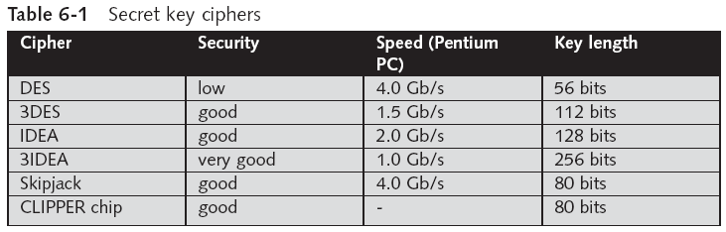
Symmetric Key Encryption (continued)
Computer Security and Penetration Testing

Slide 10
Symmetric Key Encryption (continued)
Stream Ciphers
  Use a key stream to encrypt and decrypt a plaintext message
Key stream is similar to a one-time pad
  A list of random numbers from 1 to 25
  Numbers in the one-time pad are added to the letters in the plaintext to encrypt
    And subtracted from the cyphertext to decrypt
  Algorithm XORs key stream with plaintext message
Computer Security and Penetration Testing

Slide 11
Symmetric Key Encryption (continued)
Block Ciphers
  Operate on blocks of data
Algorithm breaks the plaintext document into blocks (usually 8 or 16 bytes long)
  Operates on each block independently
Plaintext will always be padded
Block ciphers allow you to reuse keys
Computer Security and Penetration Testing

Slide 12
Asymmetric Key Algorithms
Also called public key algorithms
Two keys for encrypting and decrypting data
Each user has a public key and a private key
  Public keys can be sent unencrypted over unsecured media
Public key encrypts data
  Private key decrypt s data encrypted with public key
Computer Security and Penetration Testing

Slide 13
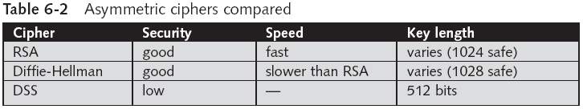
Asymmetric Key Algorithms (continued)
Computer Security and Penetration Testing

Slide 14
Asymmetric Key Algorithms (continued)
DSA (Digital Signature Algorithm)
  Digital signature connects documents with the holder of a specific key
  Considered too slow for general encryption
Digital Time Stamps
  Connects document with a specific time of origination
Computer Security and Penetration Testing

Slide 15
Cryptanalysis
Cryptanalyst decodes messages to make them readable
First and most important step in cryptanalysis
  Detecting the key values
Computer Security and Penetration Testing

Slide 16
Description of Popular Ciphers
Average user tends to confuse the categories within the cryptographic taxonomy
Computer Security and Penetration Testing

Slide 17
Symmetrical Key Ciphers
DES (Data Encryption Standard)
  A block cipher
  Developed in the early- to mid-1970s
  FIPS-approved cryptographic algorithm
  Uses a 56-bit key to encrypt and decrypt
  Breaks the plaintext into 64-bit blocks
    Applies a series of permutations to each block
  Can use same algorithm for encryption and decryption
Computer Security and Penetration Testing

Slide 18
Symmetrical Key Ciphers (continued)
Security of DES
  Dependent upon the chosen key
  Susceptible to brute-force attacks
3DES (Triple DES)
  Encrypts text three times with DES using different keys
Speed of 3DES
  Almost three times slower than DES
Security of 3DES
  Equivalent to single DES using a 112-bit key
Computer Security and Penetration Testing

Slide 19
Symmetrical Key Ciphers (continued)
AES (Advanced Encryption Standard)
  Also known as Rijndael
  Block cipher adopted as an encryption standard by the U.S. government
  Superseded DES in 2001
  Uses a block size of 128 bits, and can use either 128-, 192-, or 256-bit keys
  Input bit sequence is copied to a 4×4 array of bytes known as the State array
    Transformed via a series of substitutions/transpositions
Computer Security and Penetration Testing

Slide 20
Symmetrical Key Ciphers (continued)
Speed of AES
  Faster than DES, but slower than Blowfish
Security of AES
  All successful attacks upon AES have been through side-channel attacks
  Side-channel attacks are based on factors other than the strength of the algorithm
Computer Security and Penetration Testing

Slide 21
Symmetrical Key Ciphers (continued)
IDEA (International Data Encryption Algorithm)
  Algorithm developed at ETH Zurich, in Switzerland
  Uses a 128-bit key, and operates on 64-bit blocks
  Uses series of identical operations applied to the data for both encryption and decryption
Speed of IDEA
  Somewhat faster than 3DES, but slower than DES
Security of IDEA
  Resistant to differential cryptanalysis
  Some weak keys are known
Computer Security and Penetration Testing

Slide 22
Symmetrical Key Ciphers (continued)
Skipjack
  NSA-developed encryption algorithm that was developed for use in the Clipper chip
  Uses an 80-bit key size and operates on 64-bit blocks
  Partially vulnerable to differential cryptanalysis
RC4
  Designed by RSA Data Security, Inc.
  Main benefit of RC4 is its speed
  Can be useful where moderate security is needed
Computer Security and Penetration Testing

Slide 23
Other Symmetric Key Ciphers
Quantum Cryptography
  Method for secure key exchange over an insecure channel based on the nature of photons
  Base assumption of quantum cryptography is the Heisenberg uncertainty principle
  If a photon’s polarization is read in the same basis twice
    The polarization will be read correctly and will remain unchanged
  Quantum cryptography has a special defense against eavesdropping
Computer Security and Penetration Testing

Slide 24
Other Symmetric Key Ciphers (continued)
Blowfish
  Algorithm developed by Bruce Schneier of Counterpane Systems
Enigma
  Used by the German forces in World War II
Vigenère
  A historical and easy-to-solve substitution cipher
Computer Security and Penetration Testing

Slide 25
Asymmetric Key Ciphers
RSA (Rivest, Shamir, and Adleman)
  Most popular public key encryption standard
  RSA develops keys that are the product of two 1024-bit prime numbers
  Invented in 1977
  RSA is based on the fact that it is very difficult to factor large numbers
Security of RSA
  Some progress has been made in factoring large (300+ digit) numbers
Computer Security and Penetration Testing

Slide 26
Asymmetric Key Ciphers (continued)
Diffie-Hellman
  Allows two parties who do not have prior knowledge of each other to establish a shared secret key
    Over a public, insecure channel
  Currently considered secure
DSS (Digital Signature Standard)
  Based on the Digital Signature Algorithm (DSA)
  Used to generate digital signatures for authentication of electronic documents
  Combination of public key cryptography and a hash function
Computer Security and Penetration Testing

Slide 27
Asymmetric Key Ciphers (continued)
Elliptic Curve Cryptosystems
  Elliptic curves are harder to solve than factoring the products of large prime numbers
  Elliptic curves, as used in cryptography, are mainly defined over finite fields
  Shorter keys can be used
Neo for Java
  Uses a matrix of 251 8-bit numbers
  Said to be the equivalent of RSA-1024
Computer Security and Penetration Testing

Slide 28
Asymmetric Key Ciphers (continued)
Lattice-Based Cryptosystems
  Based on NP-complete problems involving geometric shapes built of lines or vectors
  Lattice-based systems have not proven to be effective for cryptography
    As they are too slow in practice
Computer Security and Penetration Testing

Slide 29
Cryptographic Hash Functions
Hash functions are used in cryptography to transform variable length into a fixed-size hash value
Hashes are often referred to as “digital fingerprints”
One-way hashes
  Easy to create the hash from the input data, but very difficult to recreate the input data from the hash
Message Digest Algorithm 5 (MD5)
  Secure hash algorithm developed in 1992 by Rivest
  Operates on input data using 512-bit blocks, and produces a 128-bit hash value
Computer Security and Penetration Testing

Slide 30
Cryptographic Hash Functions (continued)
SHA, SHS (Secure Hash Algorithm)
  Developed by the U.S. government and adopted as a FIPS standard
  Several variations of SHA hash functions exist
  Operates on either 512-bit blocks or 1024-bit blocks
  SHA-1 hashes are 160 bits long
  SHA-2, produce larger hashes (224, 256, 384, and 512 bits)
  Considered superior to MD5
Computer Security and Penetration Testing

Slide 31
Attacks on Passwords
Password protection is open to many kinds of attack
  From dictionary attacks to sheer guesswork
Computer Security and Penetration Testing

Slide 32
Dictionary Attacks
Guessing passwords by using a list of common words
Can determine the key necessary to decrypt an encrypted document
Usually do not work against complex passwords
Crackers need the file that contains the passwords of the target
Defense: limit the number of guesses allowed before the user is locked out
Computer Security and Penetration Testing

Slide 33
Dictionary Attacks (continued)
Hybridization attacks
  Guess passwords by creating new words
  Add letters or numbers to every word in a dictionary
  Some hybridization methods use a number spread
    Insert numbers into passwords
  Duplication: duplicating a word to form a new word
  Substituting with symbols: replacing letters in words with symbols that look similar to the missing letters
Computer Security and Penetration Testing

Slide 34
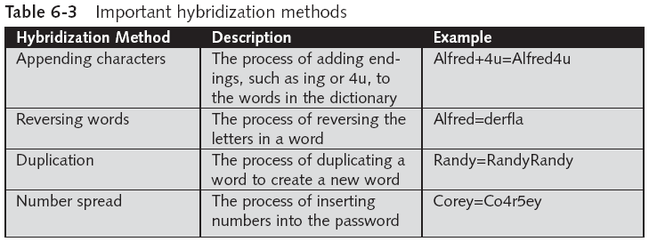
Dictionary Attacks (continued)
Computer Security and Penetration Testing

Slide 35
Dictionary Attacks (continued)
Guidelines to protect against dictionary and hybridization attacks
  Avoid using the same password for everything
  Avoid using one’s own name in a password, as well as that of a child, spouse, friend, or pet
  Avoid using common words or names for passwords
  Include random letters, numbers, and characters
  Avoid writing down difficult passwords where they might easily be found
Computer Security and Penetration Testing

Slide 36
Brute-Force Attacks
Use all possible combination of letters, numbers, and special characters to determine the target password
Very time consuming and requires patience
Slow compared to dictionary attacks
Need a large amount of RAM and a fast processor
Most effective when the encrypted document or password hash file
  Can be extracted from the target system and tested on an anonymous offline location
Computer Security and Penetration Testing

Slide 37
Observation
“Snooping,” “eavesdropping,” or “shoulder-surfing”
Used whenever an attacker has physical proximity
  And can literally watch the victim type in their username and password
Computer Security and Penetration Testing

Slide 38
Keyloggers
Records every key pressed on the target’s computer
Can easily be installed on any computer
Keyloggers are generally invisible to the victim
Computer Security and Penetration Testing

Slide 39
Social Engineering
Cracker can pretend to be a legitimate user of the target system
  And extract information simply by asking
People behave naively when a so-called computer expert questions them
Another form of social engineering is called phishing
Computer Security and Penetration Testing

Slide 40
Sniffing Methods
Crackers use packet sniffers
  To catch cleartext passwords from protocols such as Telnet, FTP, and POP3
Computer Security and Penetration Testing

Slide 41
Password File Stealing
Cracker can steal or copy the files where the password hashes are stored
  From the victim’s computer
Cracker can take all the time necessary to perform a brute-force attack
Sometimes passwords are not stored in the main system but in a shadow file
  Readable only by users with administrative privileges
Computer Security and Penetration Testing

Slide 42
Password Crackers
Some widely used cracker programs are:
  Cain and Abel
  Crack
  John the Ripper
  Telnet_crack
  THC Hydra
  L0phtCrack
Computer Security and Penetration Testing

Slide 43
Cain and Abel
Developed for Windows systems
Handles large variety of tasks and is user-friendly
Functions include
  Recover passwords by sniffing the network
  Crack encrypted passwords using dictionary, brute-force, and cryptanalysis attacks
  Record VoIP conversations
  Decode scrambled passwords
  Reveal password boxes
Computer Security and Penetration Testing

Slide 44
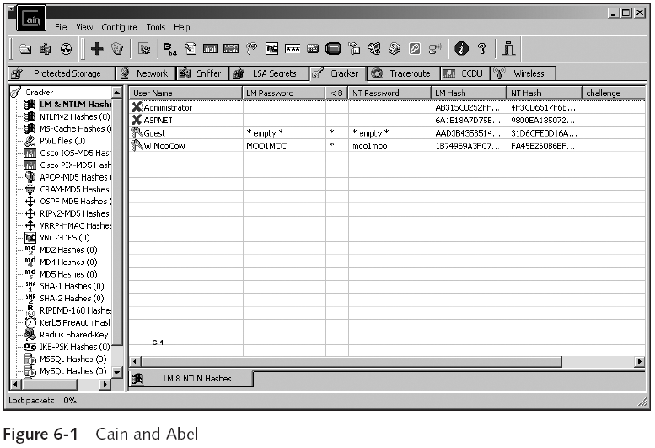
Cain and Abel (continued)
Computer Security and Penetration Testing

Slide 45
Crack
Alec Muffet designed Crack for UNIX-based systems in 1991
Scans UNIX password files and then extracts weak logon passwords
Can also detect encrypted ciphertext by using the Crypt (3) algorithm
Computer Security and Penetration Testing

Slide 46
John the Ripper
A fast password cracker
Currently available for many versions of UNIX, DOS, Win32, BeOS, and OpenVMS
Primary purpose is to detect weak UNIX passwords
Can edit its dictionary to add more common words
Modes
  Wordlist mode, single-crack mode, incremental mode, and external mode
Computer Security and Penetration Testing

Slide 47
Telnet_Crack
Uses a dictionary attack to crack Telnet account passwords
Available for UNIX and Linux platforms
Hackers must specify the Telnet account name and the IP address of the computer holding the user’s account to crack
Computer Security and Penetration Testing

Slide 48
THC Hydra
Useful network authentication cracker which supports many different services
Computer Security and Penetration Testing

Slide 49
L0phtcrack and Lc5
Developed to help system administrators and security professionals
  Check password weaknesses of the Windows NT operating system
The company that owned L0phtCrack, the @Stake company, was purchased by Symantec
Symantec has discontinued support
Computer Security and Penetration Testing

Slide 50
Summary
Requiring the use of effective, strong passwords is one of the best ways to secure a network against attackers
Basic types of cryptography include transposition and substitution ciphers
Encryption can be performed using either symmetric key algorithms or asymmetric key algorithms
Popular symmetric key ciphers include DES, 3DES, AES (Rijndael), IDEA, Skipjack, and RC4
Computer Security and Penetration Testing

Slide 51
Summary (continued)
Popular asymmetric key ciphers include RSA, Diffie-Hellman, DSS, and elliptic curve cryptography
Cryptographic hash functions generate a fixed-size hash value from a message of any length
Effective password security depends on choosing strong passwords
Common attacks on passwords include technical measures and physical techniques
Password-cracking programs are readily available
Computer Security and Penetration Testing

